Slide 1

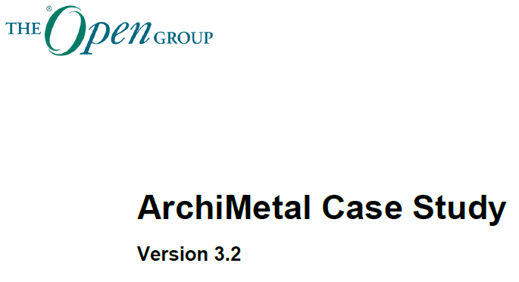

ArchiMetal Modeling Practice
Using Archi Tool
Please follow: https://github.com/yasenstar/ArchiMetal_Practice.
Check online page: https://yasenstar.github.io/ArchiMetal_Practice/

Slide 2

Initialization
Overview of ArchiMetal Case Study
Repository in GitHub
Mindmap for Structure
Create Initial Archi Model

